Slide 1
Tech Interview Prep:
CDNs, Load Balancers, and Secure Connectivity
Section 1: Content Delivery Networks (CDNs) & Edge Performance
Section 2: Load Balancers: Traffic Distribution & Availability
Section 3: Virtual Private Networks (VPNs) in System Architecture
Section 4: Architecture Synthesis
Name: Dara Sen
Class: AD371 (Application architecture)

Slide 2
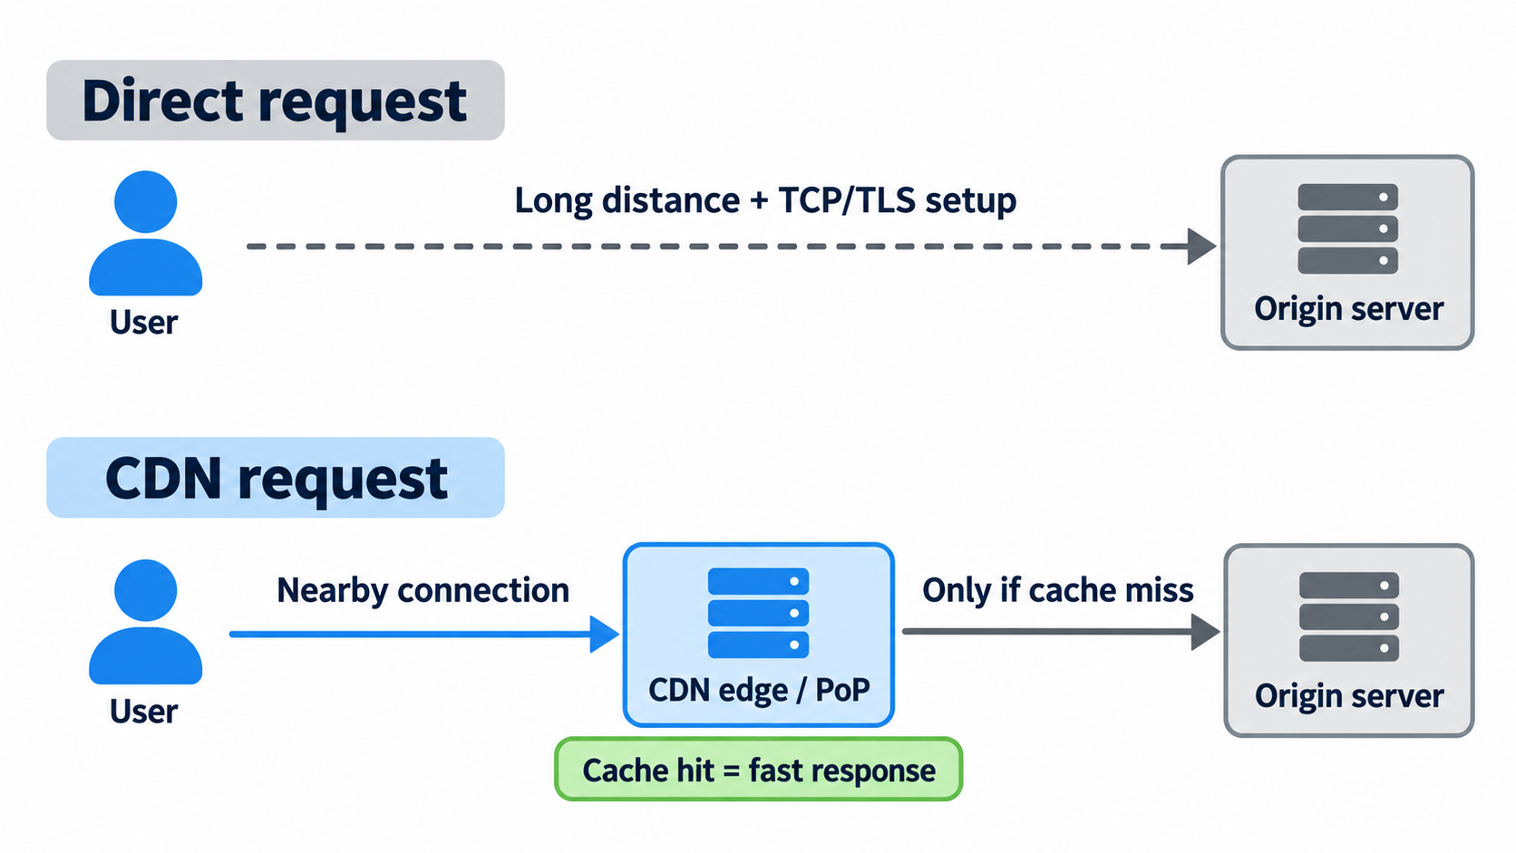
Section 1: Content Delivery Networks (CDNs) & Edge Performance

Slide 3
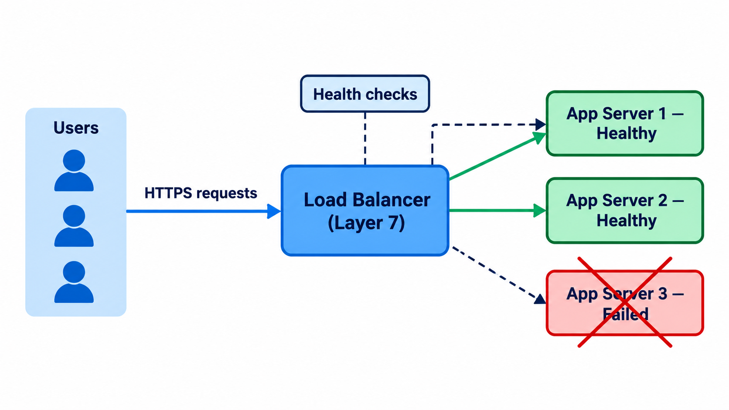
Section 2: Load Balancers: Traffic Distribution & Availability

Slide 4
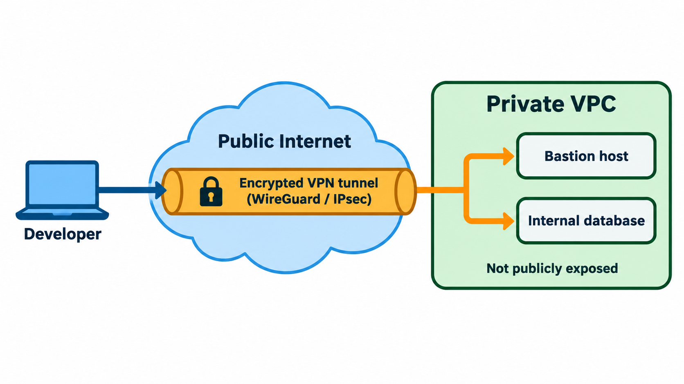
Section 3: Virtual Private Networks (VPNs) in System Architecture

Slide 5
Section 4: Architecture Synthesis
CDN – improves speed by serving content close to users.
Load Balancer – improves reliability by distributing traffic across healthy servers.
VPN – protects private administrative and infrastructure access.

